Slide 1
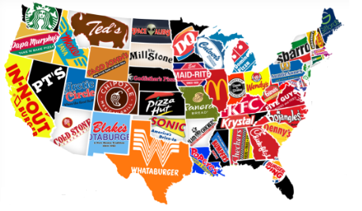
Fast-Food Restaurants USA Case Study
by Sunitha Sharma

Slide 2
FAST-FOOD Restaurants
We have the List of Popular Fast-Food Restaurants in USA.
About 23 Fast-Food Chains like Subway, MC Donald's, Arby with their address details are provided.
A Particular Fast-Food Restaurant has multiple chains in provinces of USA.
The dataset could help us analyzing the Top 10 Fast-Food Restaurants in USA and spread of Restaurants in a Particular Province.
The Restaurant's request would be that we add some functionality that would allow the user to "Find Locations Near Me“ and order food on Mobile Phone.

Slide 3
FAST-FOOD Restaurants dataset
The dataset is of a List of Fast-Food Restaurants in USA, the dataset available are Latitude, Longitude, Postal Code, Province, Website of the Restaurants.
We have 10 Variable Types and out of which Country has a Constant Value.
2 Variables are of Numeric Values ( Float) and all the rest are Categorical Values (Object).
The Latitude and Longitude are the Numeric Values (Float).

Slide 4
FAST-FOOD Restaurants dataset Summary
Float: Latitude and Longitude
Object: Everything else
Country has constant Value US.
Address has Distinct Values of 9934.
City as well has Distinct Values.
Name, Postal Code and Province also have Distinct Values.
The Websites have 465 Missing Values, which indicates not all Fast-Food Restaurants have websites.

Slide 5
Identify patterns in the data
Analysis:
Most Common Fast-Food Restaurants in USA
List of 10 Provinces which have a Higher spread of Fast-Food chains
List of cities which have higher number of Fast-Food chains
Higher Number of Fast-Food Chains for postal-Code

Slide 6
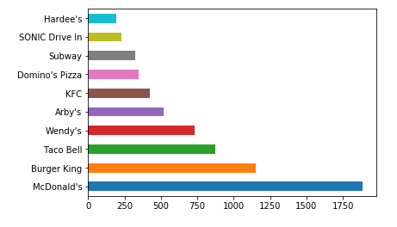
Objectives & Graphs

Slide 7
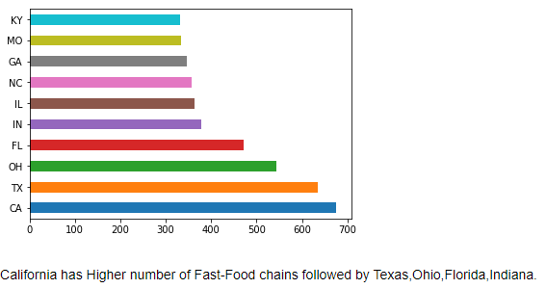
Objectives & Graphs

Slide 8
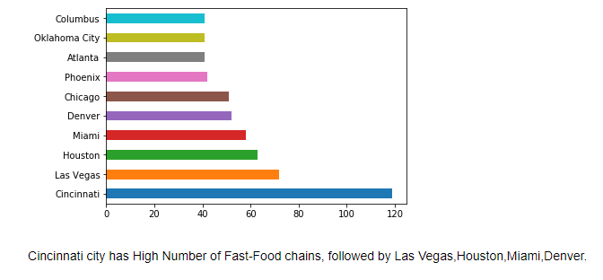
Objectives & Graphs

Slide 9
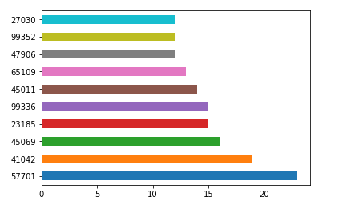
Objectives & Graphs

Slide 10
Conclusion
1.McDonald's and Burger King are having Fast-Food Restaurants in almost all the parts of USA
2.The Density of Fast-Food Restaurants are higher in California, Texas, Ohio, Florida and Indiana Provinces.
3.Not all restaurants have websites, about 465 Fast-Food Restaurants have the websites missing.
4.McDonald's has the website available and also top restaurants like Wendy's, Burger King and KFC.
5.I have not made use of the Variables Keys, Longitude and Latitude.
I understand the Longitude and Latitude mentioned can be used for finding the distances on Google Map and users can find a Fast-Food Restaurants nearby.
6.Overall the outcome is the Top 5 Fast-Food Chains are McDonald's, Burger King , Taco Bell, Wendy's and Arby's which are spread in Higher density in California, Texas, Ohio, Florida, Indiana.

